Slide 1
Controllable Generation from Pre-trained Language Models via Inverse Prompting
Advisor: JIA-LING, KOH
Source: KDD’21
SPEAKER: Rui Ze Fang
DATE: 2021/10/5

Slide 2
Outline
Introduction
Method
Experiment
Conclusion

Slide 3
Introduction
prompt
Generated Model
Q: Is the apple taste good?
A: yes, it is a juice apple ……
Challenge: Generated content is irrelevant

Slide 4
Introduction
Q: Is the apple taste good?
Generated Model
Question “Is the apple taste good?” can answered by “Yes, it is a juice apple ……”
A: yes, it is a juice apple ……
“Yes, it is a juice apple ……” can answer Question “Is the apple taste good?”
Generated Model
Q: Is the apple taste good?
A: yes, it is a juice apple ……

Slide 5
Outline
Introduction
Method
Experiment
Conclusion

Slide 6
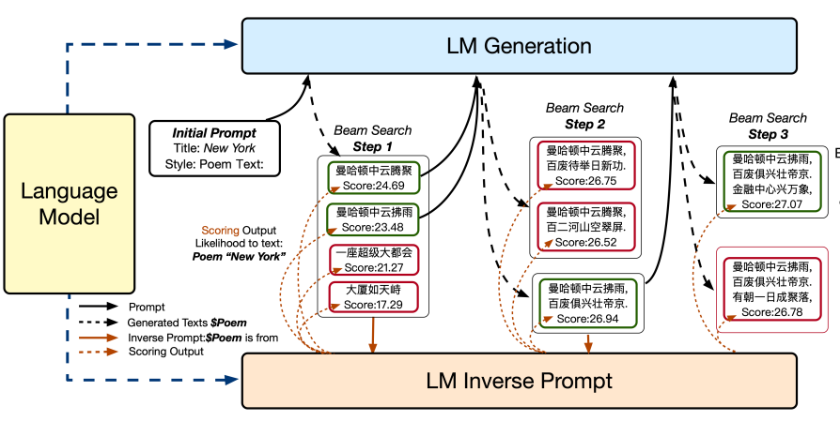
Method

Slide 7
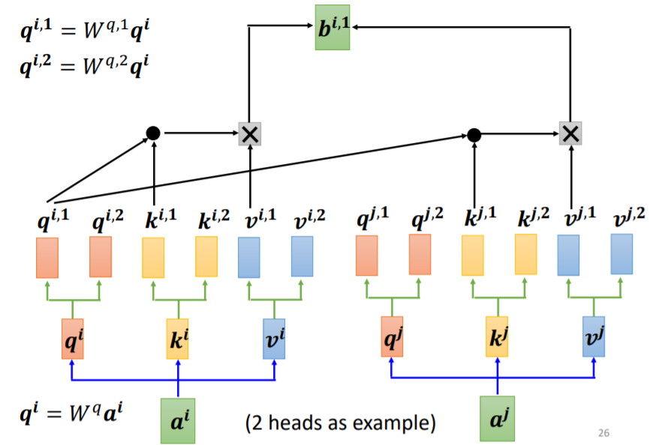
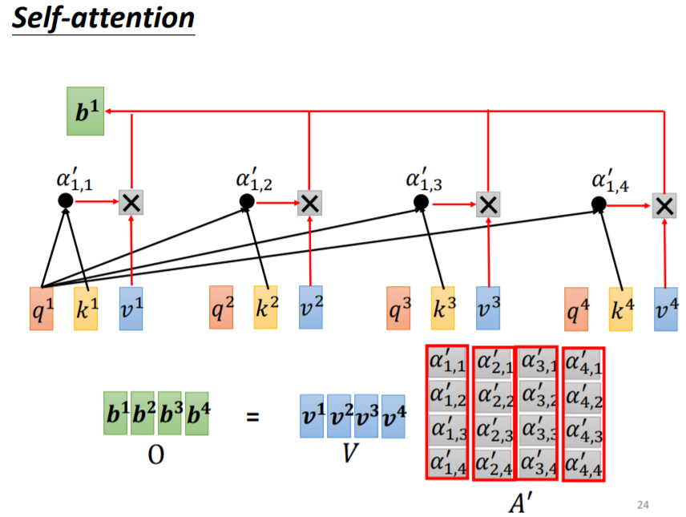
Multi-head attention
來自李宏毅教授投影片內容

Slide 8
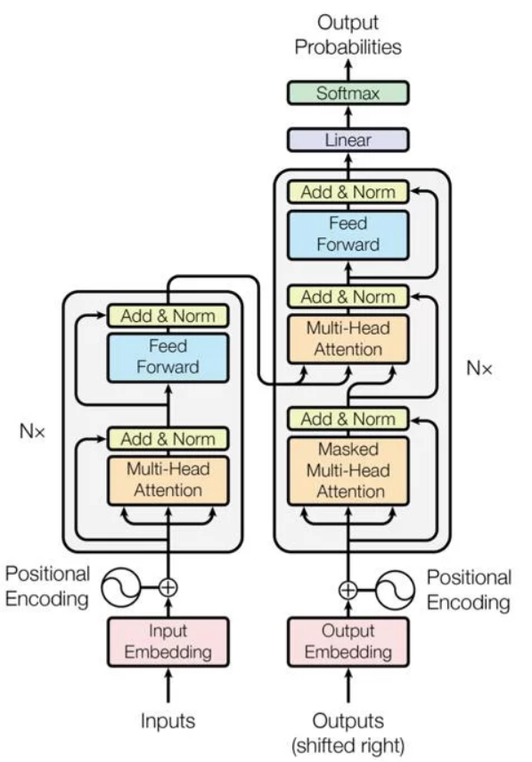
Method - language model (transformer)
Encoder
Decoder
Multi-head attention
Decoder
Question: Is it an apple?
Encoder
Answer: Yes, it is.

Slide 9
Method - Beam Search
在每個組合的機率值中挑選前2個score高
Beam size = 4
Score: 24
在每個句的機率值中挑選前4高
Score: 21
Score: 15
Score: 10
step1
step2
Score:

Slide 10
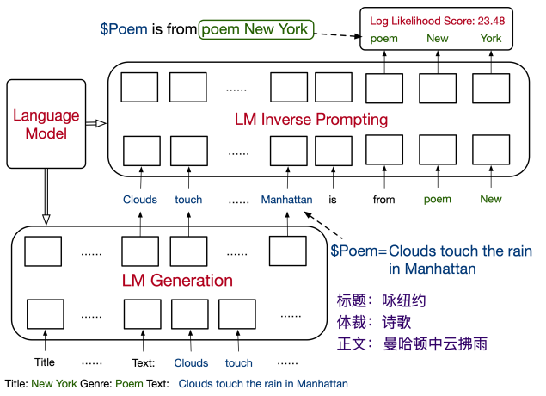
Method - loss function
Question-Answering
Poem Generation

Slide 11
Outline
Introduction
Method
Experiment
Conclusion

Slide 12
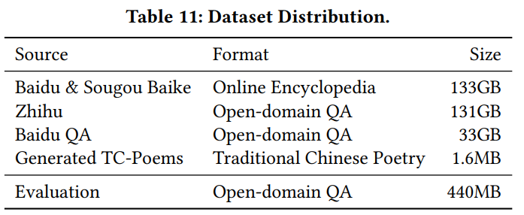
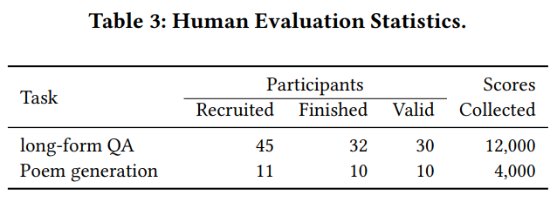
Dataset and Human test

Slide 13
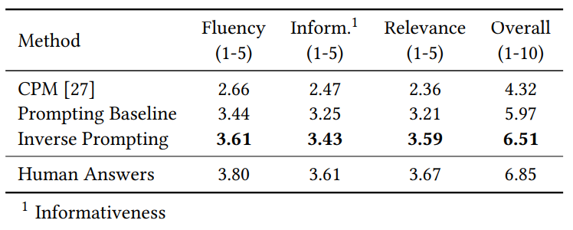
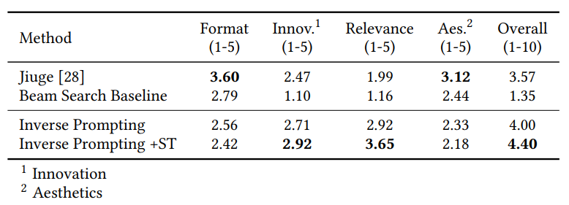
Experiment
Question-Answering
Poem Generation

Slide 14
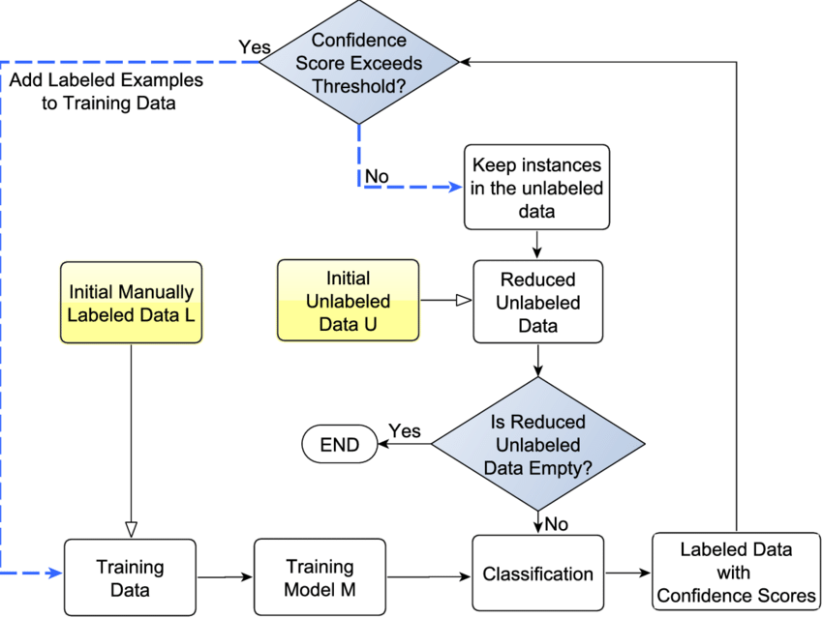
Method – self training
Input: Title output: poem
Unlabeled data: Title
Confidence Score:

Slide 15
Conclusion
利用Inverse prompting的想法，生成出的文本能夠與給的問題或詩的主題更相關
在生成相關文本的同時，也能達到不錯的文本質量

